Slide 1
Session 12 : Selection Widgets
Module 4.3 : Android

Slide 2
Learning Objectives
At the end of the session successful participants will be able to
Create following:
RadioButtons and CheckButtons
ArrayAdapter
Spin Control
GridView
AutoComplete TextView
Gallery Widget
Customized Lists

Slide 3
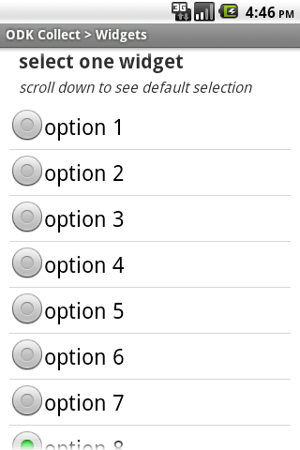
Selection Widgets
Widgets to Select

Slide 4
Selection Widgets
Widgets to Select
RadioButtons and CheckButtons are suitable for selecting from a small set of options.
When the pool of choices is larger other widgets are more appropriate, those include classic UI controls such as: listboxes, comboboxes, drop-down lists, picture galleries, etc.

Slide 5
Selection Widgets
Widgets to Select
Android offers a framework of data adapters that provide a common interface to selection lists ranging from static arrays to database contents.
Selection views –widgets for presenting lists of choices –are handed an adapter to supply the actual choices.

Slide 6
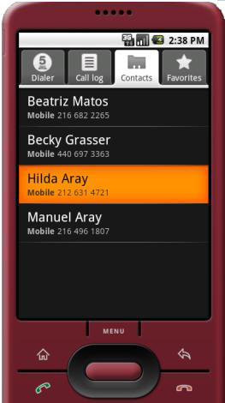
Selection Widgets
Displaying/Selecting Options
Selection
DATA
Destination layout Holding a ListView
Formatted & Bound Data
Raw Data
DATA ADAPTER

Slide 7
Selection Widgets
Using ArrayAdapter
The easiest adapter to use is ArrayAdapter – all you need to do is wrap one of these around a Java array or java.util. List instance, and you have a fully functioning adapter:
String[] items={"this", "is", "a","really", "silly", "list"};
new ArrayAdapter<String>(this,android.R.layout.simple_list_item_1,items);

Slide 8
Selection Widgets
Using ArrayAdapter
The ArrayAdapter constructor takes three parameters:
The Contextto use (typically thiswill be your activity instance)
The resource ID of a viewto use (such as the built-in system resource android.R.layout.simple_list_item_1 as shown above)
The actual (source) array or list of items to show

Slide 9
Selection Widgets
Using ArrayAdapter: Example
Instead of Activity we will use a ListActivity which is an Android class specializing in the use of ListViews.
<?xml version="1.0" encoding="utf-8"?> <LinearLayout
xmlns:android=http://schemas.android.com/apk/res/android android:orientation="vertical“ android:layout_width="fill_parent" android:layout_height="fill_parent" > <TextView android:id="@+id/selection“ android:layout_width="fill_parent“ android:layout_height="wrap_content" android:background="#ff0000cc“
android:textStyle="bold“ />
<!--Here is the list. Since we are using a ListActivity, we have to call it "@android:id/list" so ListActivitywill find it -->

Slide 10
Selection Widgets
Using ArrayAdapter: Example
Instead of Activity we will use a ListActivity which is an Android class specializing in the use of ListViews.
<ListView android:id="@android:id/list“ android:layout_width="fill_parent" android:layout_height="fill_parent“ android:drawSelectorOnTop="false" /> <TextViewandroid:id="@android:id/empty“ android:layout_width="wrap_content“ android:layout_height="wrap_content“
android:text="Empty set" /></LinearLayout>

Slide 11
Selection Widgets
Using ArrayAdapter: Example
packagecis493.selectionwidgets;
importandroid.app.ListActivity;
importandroid.os.Bundle;
importandroid.view.View;
importandroid.widget.ArrayAdapter;
importandroid.widget.ListView;
importandroid.widget.TextView;
publicclassArrayAdapterDemoextendsListActivity{
TextViewselection;
String[] items= { "this", "is", "a", "really“,"really2", "really3","really4“,"really5", "silly", "list"};
// next time try an empty list such as:
// String[] items = {};
NOTE: The ListActivity class is implicitly bound to an object identified by @android:id/list

Slide 12
Selection Widgets
Using ArrayAdapter: Example
@Override
publicvoidonCreate(Bundle savedInstanceState) {super.onCreate(savedInstanceState);
setContentView(R.layout.main);
setListAdapter(newArrayAdapter<String>(this,android.R.layout.simple_list_item_1,items));
selection=(TextView)findViewById(R.id.selection);}
@Override
Protected void onListItemClick(ListViewl, View v, intposition, longid)
{super.onListItemClick(l, v, position, id);
String text = " position:"+ position + " "+ items[position];
selection.setText(text);}}

Slide 13
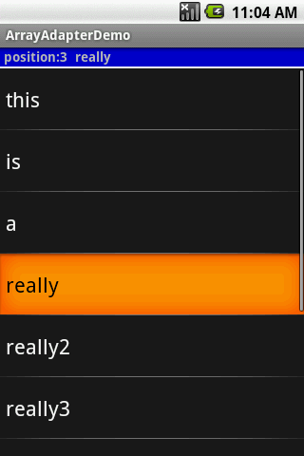
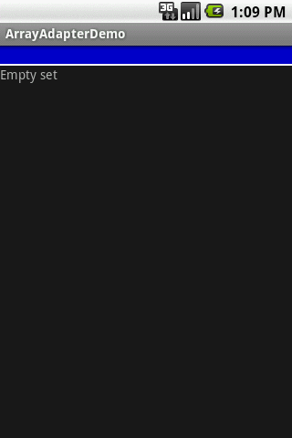
Selection Widgets
Using ArrayAdapter: Example

Slide 14

Selection Widgets
Spin Control
In Android, the Spinner is the equivalent of the drop-down selector.
Spinners have the same functionality of a ListView but take less space.
As with ListView, you provide the adapter for linking data to child views using setAdapter()
Add a listener object to capture selections made from the list with setOnItemSelectedListener()
Use the setDropDownViewResource() method to supply the resource ID of the multi-line selection list view to use.

Slide 15
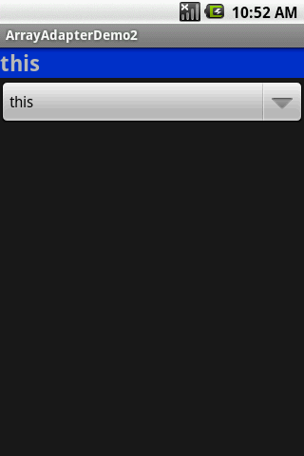
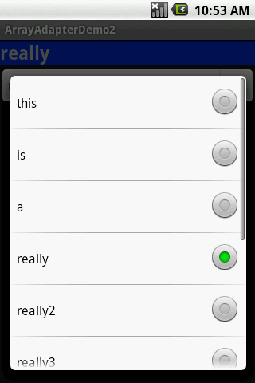
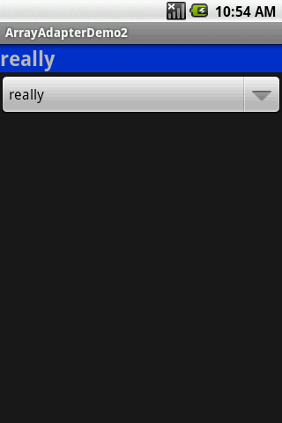
Selection Widgets
Spin Control: Example
Click here
Select this option
Selected value

Slide 16
Selection Widgets
Spin Control: Example
<?xml version="1.0" encoding="utf-8"?>
<LinearLayout
android:id="@+id/myLinearLayout"
android:layout_width="fill_parent"
android:layout_height="fill_parent"
android:orientation="vertical"
xmlns:android="http://schemas.android.com/apk/res/android"
>
<TextView
android:id="@+id/selection"
android:layout_width="fill_parent"
android:layout_height="wrap_content"
android:background="#ff0033cc"
android:textSize="14pt”

Slide 17
Selection Widgets
Spin Control: Example
android:textStyle="bold"
>
</TextView>
<Spinner
android:id="@+id/spinner"
android:layout_width="fill_parent"
android:layout_height="wrap_content"
>
</Spinner>
</LinearLayout>

Slide 18
Selection Widgets
Spin Control: Example
Packagecis 493.selectionwidgets;
Import android.app.Activity;
Import android.os.Bundle;
Import android.view.View;
Import android.widget.AdapterView;
Import android.widget.ArrayAdapter;
Import android.widget.Spinner;
Import android.widget.TextView;
Public class ArrayAdapterDemo2 extends Activity
implements AdapterView.OnItemSelectedListener{
TextViewselection;
String[] items= { "this", "is", "a", "really", "really2", "really3", "really4", "really5", "silly", "list"};

Slide 19
Selection Widgets
Spin Control: Example
@Override
publicvoidonCreate(Bundle icicle) {
super.onCreate(icicle);
setContentView(R.layout.main);
selection= (TextView) findViewById(R.id.selection);
Spinner spin = (Spinner) findViewById(R.id.spinner);
spin.setOnItemSelectedListener(this);
// set a clickable right push-button comboBoxto show items
ArrayAdapter<String> aa= newArrayAdapter<String>(
this, android.R.layout.simple_spinner_item, items);
// provide a particular design for the drop-down lines
aa.setDropDownViewResource(
android.R.layout.simple_spinner_dropdown_item);
// associate GUI spinner and adapter

Slide 20
Selection Widgets
Spin Control: Example
spin.setAdapter(aa);
}
// ////////////////////////////////////////////////////////////////////
publicvoidonItemSelected(
AdapterView<?> parent, View v, intposition, longid) {
selection.setText(items[position]);
}
publicvoidonNothingSelected(AdapterView<?> parent) {
selection.setText("");
}
}

Slide 21
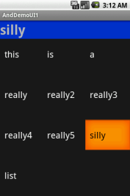
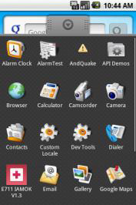
Selection Widgets
GridView
GridView is a ViewGroup that displays items in a two-dimensional, scrollable grid.
The grid items are automatically inserted to the layout using a ListAdapter.

Slide 22
Selection Widgets
GridView
Some properties used to determine the number of columns and their sizes:
android:numColumns spells out how many columns there are, or, if you supply a value of auto_fit, Android will compute the number of columns based on available space and the properties listed below.
android:verticalSpacing and its counterpart android:horizontalSpacing indicate how much whitespace there should be between items in the grid.

Slide 23
Selection Widgets
GridView
Some properties used to determine the number of columns and their sizes:
android:columnWidth indicates how many pixels wide each column should be.
android:stretchMode indicates, for grids with auto_fit for android:numColumns, what should happen for any available space not taken up by columns or spacing .

Slide 24
Selection Widgets
GridView
Fitting the View: Suppose the screen is 320pixels wide, and we have
android:columnWidth set to 100px
android:horizontalSpacing set to 5px

Slide 25
Selection Widgets
GridView
Three columns would use 310 pixels (three columns of 100 pixels and two whitespaces of 5 pixels).
With android:stretchMode set to columnWidth, the three columns will each expand by 3-4 pixels to use up the remaining 10 pixels.
With android:stretchMode set to spacingWidth, the two internal whitespaces will each grow by 5 pixels to consume the remaining 10 pixels.

Slide 26
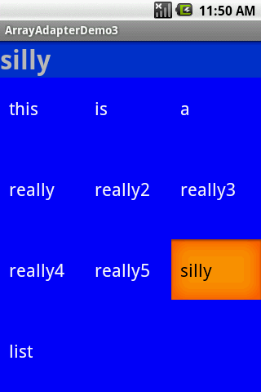
Selection Widgets
GridView
<?xml version="1.0" encoding="utf-8"?>
<LinearLayout
xmlns:android="http://schemas.android.com/apk/res/android"
android:orientation="vertical"
android:layout_width="fill_parent"
android:layout_height="fill_parent"
>
<TextView
android:id="@+id/selection"
android:layout_width="fill_parent"
android:layout_height="wrap_content"
android:background="#ff0033cc"
android:textSize="14pt"
android:textStyle="bold”

Slide 27
Selection Widgets
GridView
/>
<GridView
android:id="@+id/grid“android:background="#ff0000ff"
android:layout_width="fill_parent"
android:layout_height="fill_parent"
android:verticalSpacing="35px"
android:horizontalSpacing="5px"
android:numColumns="auto_fit"
android:columnWidth="100px"
android:stretchMode="columnWidth"
android:gravity="center"
/>
</LinearLayout>

Slide 28
Selection Widgets
GridView
packagecis493.selectionwidgets;// using a gridviewimportandroid.app.Activity;
importandroid.os.Bundle;
importandroid.view.View;
importandroid.widget.AdapterView;
importandroid.widget.ArrayAdapter;
importandroid.widget.GridView;
importandroid.widget.TextView;
publicclassArrayAdapterDemo3 extendsActivity implements AdapterView.OnItemClickListener{TextViewselection;
String[] items= {"this", "is", "a", "really", "really2", "really3","really4", "really5", "silly", "list"};

Slide 29
Selection Widgets
GridView
@Override
publicvoidonCreate(Bundle icicle) {
super.onCreate(icicle);
setContentView(R.layout.main);
selection= (TextView) findViewById(R.id.selection);
GridViewgv= (GridView) findViewById(R.id.grid);
ArrayAdapter<String> aa= newArrayAdapter<String>(
this,
android.R.layout.simple_list_item_1,
items);
gv.setAdapter(aa);
gv.setOnItemClickListener(this);}

Slide 30
Selection Widgets
GridView
publicvoidonItemClick(AdapterView<?> parent, View v,
intposition, longid) {
selection.setText(items[position]);
}
}// class

Slide 31
Selection Widgets
AutoComplete TextView
With auto-completion, as the user types, the text is treated as a prefix filter, comparing the entered text as a prefix against a list of candidates.
Matches are shown in a selection list that, like with Spinner, folds down from the field.
The user can either type out a new entry (e.g., something not in the list) or choose an entry from the list to be the value of the field.

Slide 32
Selection Widgets
AutoComplete TextView
AutoCompleteTextView subclasses EditText, so you can configure all the standard look-and-feel aspects, such as font face and color.
AutoCompleteTextViewhas a android:completionThresholdproperty, to indicate the minimum number of characters a user must enter before the list filtering begins.

Slide 33
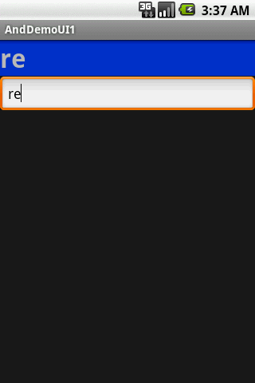
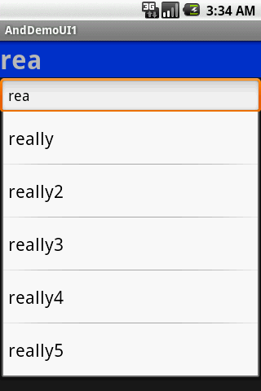
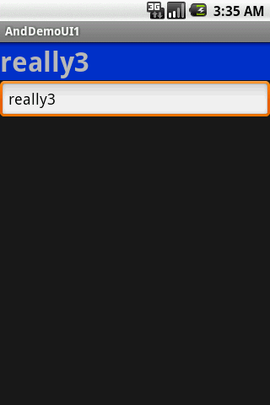
Selection Widgets
AutoComplete TextView

Slide 34
Selection Widgets
AutoComplete TextView: Example
<?xml version="1.0" encoding="utf-8"?>
<LinearLayout
xmlns:android="http://schemas.android.com/apk/res/android"
android:orientation="vertical"
android:layout_width="fill_parent"
android:layout_height="fill_parent”>
<TextView
android:id="@+id/selection"
android:layout_width="fill_parent"
android:layout_height="wrap_content"
android:background="#ff0033cc"
android:textSize="14pt"
android:textStyle="bold”/>

Slide 35
Selection Widgets
AutoComplete TextView: Example
<AutoCompleteTextView
android:id="@+id/edit"
android:layout_width="fill_parent"
android:layout_height="wrap_content"android:completionThreshold="3“
/>
</LinearLayout>

Slide 36
Selection Widgets
AutoComplete TextView: Example
Package cis493.selectionwidgets;
Import android.app.Activity;
Import android.os.Bundle;
Import android.text.Editable;
Import android.text.TextWatcher;
Import android.widget.ArrayAdapter;
Import android.widget.AutoCompleteTextView;
Import android.widget.TextView;
Public classAndDemoUI1 extendsActivity implementsTextWatcher{
TextViewselection;
AutoCompleteTextViewedit;
String[] items= { "this", "is", "a", "really", "really2", "really3", "really4", "really5", "silly", "list"};

Slide 37
Selection Widgets
AutoComplete TextView: Example
@Override
publicvoidonCreate(Bundle icicle) {
super.onCreate(icicle);
setContentView(R.layout.main);
selection= (TextView) findViewById(R.id.selection);
edit= (AutoCompleteTextView) findViewById(R.id.edit);
edit.addTextChangedListener(this);
edit.setAdapter(newArrayAdapter<String>(this,
android.R.layout.simple_dropdown_item_1line, items));
}
publicvoidonTextChanged(CharSequences, intstart, intbefore, intcount) {
selection.setText(edit.getText());
}

Slide 38
Selection Widgets
AutoComplete TextView: Example
publicvoidbeforeTextChanged(CharSequences, intstart,
intcount, intafter) {
// needed for interface, but not used
}
publicvoidafterTextChanged(Editable s) {
// needed for interface, but not used
}
}

Slide 39
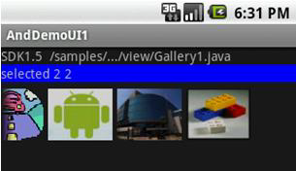
Selection Widgets
Gallery Widget
The Gallery widget provides a set of options depicted as images.
Image choices are offered on a contiguous horizontal mode, you may scroll across the image-set.

Slide 40
Selection Widgets
Gallery Widget
<?xml version="1.0" encoding="utf-8"?>
<LinearLayoutxmlns:android="http://schemas.android.com/apk/res/android"
android:orientation="vertical"
android:layout_width="fill_parent"
android:layout_height="fill_parent"
>
<TextView
android:layout_width="fill_parent"
android:layout_height="wrap_content"
android:text="SDK1.5 /samples/.../view/Gallery1.java"
/>
<TextView
android:id="@+id/mySelection"
android:layout_width="fill_parent”

Slide 41
Selection Widgets
Gallery Widget
android:layout_height="wrap_content"
android:background="#ff0000ff"
/>
<Gallery
android:id="@+id/myGallery"
android:layout_width="fill_parent"
android:layout_height="wrap_content"
android:gravity="bottom"
/>
</LinearLayout>

Slide 42
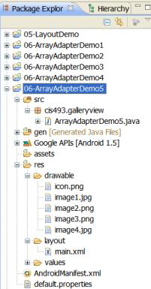
Selection Widgets
Gallery Widget
package cis493.selectionwidgets;
import android.app.Activity;
import android.content.Context;
import android.os.Bundle;
import android.view.View;
import android.view.ViewGroup;
import android.widget.AdapterView;
import android.widget.BaseAdapter;
import android.widget.Gallery;
import android.widget.ImageView;
import android.widget.TextView;
import android.widget.AdapterView.OnItemSelectedListener;

Slide 43
Selection Widgets
Gallery Widget
public class AndDemoUI1 extends Activity {
// Using Gallery widget. G1 phone resolution: HVGA 320x480 px
// code adapted from:
// C:\Android\platforms\android-1.5\samples\ApiDemos\
// src\com\example\android\apis\view\Galler1.java
TextViewmySelection;
Gallery myGallery;

Slide 44
Selection Widgets
Gallery Widget
@Override
public void onCreate(Bundle icicle) {
super.onCreate(icicle);
setContentView(R.layout.main);
mySelection = (TextView) findViewById(R.id.mySelection);
// Bind the gallery defined in the main.xml
// Apply a new (customized) ImageAdapter to it.
myGallery = (Gallery) findViewById(R.id.myGallery);
myGallery.setAdapter(new ImageAdapter(this));

Slide 45
Selection Widgets
Gallery Widget
myGallery.setOnItemSelectedListener(new OnItemSelectedListener() {
@Override
public void onItemSelected(AdapterView<?> arg0, View arg1,
int arg2, long arg3) {
mySelection.setText(" selected option: " + arg2 );
}
@Override
public void onNothingSelected(AdapterView<?> arg0) {
mySelection.setText("Nothing selected");}});}// onCreate

Slide 46
Selection Widgets
Gallery Widget
public class ImageAdapter extends BaseAdapter {
/** The parent context */
private Context myContext;
// Put some images to project-folder: /res/drawable/
// format: jpg, gif, png, bmp, ...
private int[] myImageIds = { R.drawable.image1, R.drawable.image2,
R.drawable.image3, R.drawable.image4 };
/** Simple Constructor saving the 'parent' context. */
public ImageAdapter(Context c) {
this.myContext = c;
}
// inherited abstract methods - must be implemented
// Returns count of images, and individual IDs

Slide 47
Selection Widgets
Gallery Widget
public int getCount() {
return this.myImageIds.length;
}
public Object getItem(int position) {
return position;
}
public long getItemId(int position) {
return position;
}
// Returns a new ImageViewto be displayed,
publicView getView(intposition, View convertView,
ViewGroupparent) {
// Get a View to display image data
ImageViewiv = newImageView(this.myContext);

Slide 48
Selection Widgets
Gallery Widget
iv.setImageResource(this.myImageIds[position]);
// Image should be scaled somehow
//iv.setScaleType(ImageView.ScaleType.CENTER);
//iv.setScaleType(ImageView.ScaleType.CENTER_CROP);
//iv.setScaleType(ImageView.ScaleType.CENTER_INSIDE);
//iv.setScaleType(ImageView.ScaleType.FIT_CENTER);
//iv.setScaleType(ImageView.ScaleType.FIT_XY);
iv.setScaleType(ImageView.ScaleType.FIT_END);
// Set the Width & Height of the individual images
iv.setLayoutParams(newGallery.LayoutParams(95, 70));returniv;
}
}// ImageAdapter
}// class

Slide 49
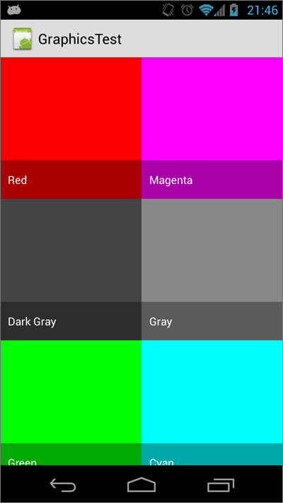
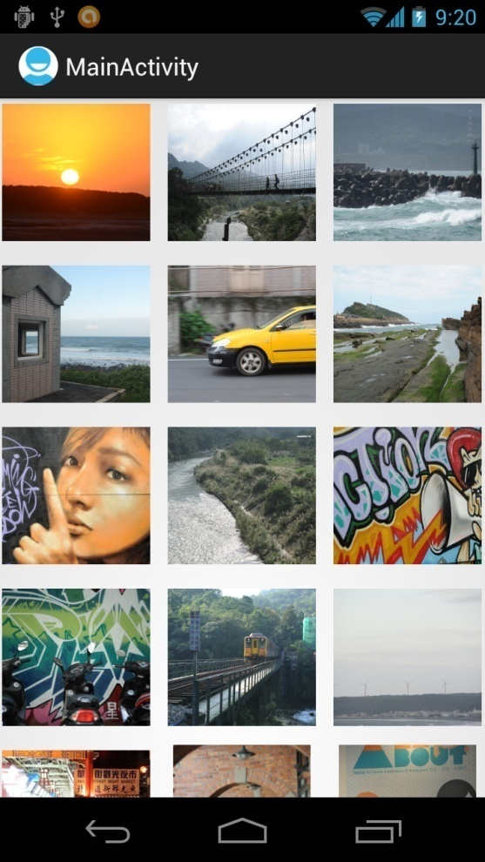
Selection Widgets
GridView (Again)

Slide 50
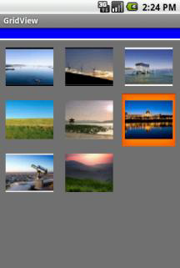
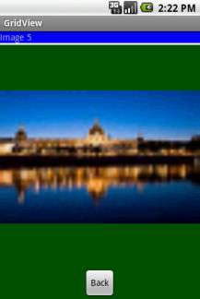
Selection Widgets
GridView (Again)
A – perhaps - more interesting version of the GridView control uses images instead of text.
The programmer must supply an ImageAdapter to indicate what to do when an individual image is selected/clicked.

Slide 51
Selection Widgets
GridView (Again): main.xml
<?xml version="1.0" encoding="utf-8"?>
<LinearLayoutxmlns:android="http://schemas.android.com/apk/res/android"
android:orientation="vertical"
android:layout_width="fill_parent"
android:layout_height="fill_parent"
>
<TextView
android:id="@+id/tvMsg"
android:layout_width="fill_parent"
android:layout_height="wrap_content"
android:background="#ff0000ff"
/>
<TextView

Slide 52
Selection Widgets
GridView (Again): main.xml
android:layout_width="fill_parent"
android:layout_height="3px"
android:background="#ffffffff”/><GridView
android:id="@+id/gridview"
android:layout_width="fill_parent"
android:layout_height="fill_parent"
android:numColumns="auto_fit"
android:verticalSpacing="10dp"
android:horizontalSpacing="10dp"
android:columnWidth="90dp"
android:stretchMode="columnWidth"
android:gravity="center"
android:background="#ff777777" />
</LinearLayout>

Slide 53
Selection Widgets
GridView (Again): solo_picture.xml
<?xml version="1.0" encoding="utf-8"?>
<LinearLayoutxmlns:android="http://schemas.android.com/apk/res/android"
android:orientation="vertical"
android:layout_width="fill_parent"
android:layout_height="fill_parent"
android:background="#ff005500" >
<TextView
android:id="@+id/tvSoloMsg"
android:layout_width="fill_parent"
android:layout_height="wrap_content"
android:background="#ff0000ff" />
<TextView
android:layout_width="fill_parent"
android:layout_height="3px”

Slide 54
Selection Widgets
GridView (Again): main.xml
android:background="#ffffffff" /><ImageView
android:id="@+id/imgSoloPhoto"
android:layout_width="fill_parent"
android:layout_height="fill_parent"
android:layout_gravity="center|fill"
android:layout_weight="2“ />
<Button
android:text="Back"
android:id="@+id/btnBack"
android:layout_width="wrap_content"
android:layout_height="wrap_content"
android:layout_gravity="center_horizontal" />
</LinearLayout>

Slide 55
Selection Widgets
GridView (Again)
Package cis493.matos;
/* ---------------------------------------------------------
References:
Website on which you could make free thumbnails:
http: www.makeathumbnail.com/thumbnail.php
------------------------------------------------------------
GOAL: displaying a number of pictures in a GridView. Example taken from:
http: developer.android.com/guide/tutorials/views/hello-gridview.html
------------------------------------------------------------
Reference: http://developer.android.com/guide/practices/screens_support.html
pxPixels -corresponds to actual pixels on the screen.

Slide 56
Selection Widgets
GridView (Again)
dpDensity-independent Pixels (dip) -an abstract unit that is based on the
physical density of the screen. These units are relative to a
160 dpi screen, so one dpis one pixel on a 160 dpi screen.
------------------------------------------------------------
*/
import android.app.Activity;
import android.content.Context;
import android.os.Bundle;
import android.view.View;
import android.view.ViewGroup;
import android.view.View.OnClickListener;
import android.widget.AdapterView;
import android.widget.BaseAdapter;

Slide 57
Selection Widgets
GridView (Again)
Import android.widget.Button;
Import android.widget.GridView;
Import android.widget.ImageView;
Import android.widget.TextView;
Import android.widget.Toast;
Import android.widget.AdapterView.OnItemClickListener;

Slide 58
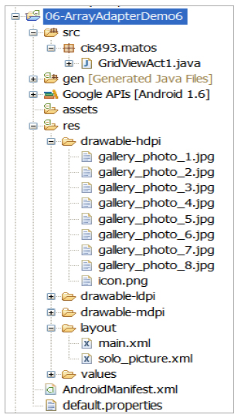
Selection Widgets
GridView (Again)
public class GridViewAct1 extends Activity implements OnItemClickListener {
TextView tvMsg;
GridView gridview;
TextView tvSoloMsg;
Integer[] mThumbIds;
ImageView ivSoloPicture;
Button btnBack;
@Override
public void onCreate(Bundle savedInstanceState) {
super.onCreate(savedInstanceState);
myMemoryBundle = savedInstanceState;
setContentView(R.layout.main);

Slide 59
Selection Widgets
GridView (Again)
tvMsg = (TextView )findViewById(R.id.tvMsg);
//initialize array of images with a few pictures
mThumbIds = new Integer[] {
R.drawable.gallery_photo_1, R.drawable.gallery_photo_2,
R.drawable.gallery_photo_3, R.drawable.gallery_photo_4,
R.drawable.gallery_photo_5, R.drawable.gallery_photo_6,
R.drawable.gallery_photo_7, R.drawable.gallery_photo_8
};
gridview = (GridView) findViewById(R.id.gridview);

Slide 60
Selection Widgets
GridView (Again)
gridview.setAdapter(new ImageAdapter(this));
gridview.setOnItemClickListener(this);
}//onCreate

Slide 61
Selection Widgets
GridView (Again)
// this nested class could also be placed as a separated class
public class ImageAdapter extends BaseAdapter {
private Context mContext;
public ImageAdapter(Context c) {
mContext = c;
}
public int getCount() {
return mThumbIds.length;
}
public Object getItem(int position) {
Toast.makeText(getApplicationContext(), "Pos: " + position, 1).show();
return null;
}

Slide 62
Selection Widgets
GridView (Again)
public long getItemId(int position) {
return 0;
}
// create a new ImageView for each item referenced by the Adapter
public View getView(int position, View convertView, ViewGroup parent) {
ImageView imageView;
if (convertView == null) {
// if it's not recycled, initialize some attributes
imageView = new ImageView(mContext);
imageView.setLayoutParams(new GridView.LayoutParams(85, 85));
imageView.setScaleType(ImageView.ScaleType.CENTER_CROP);
imageView.setPadding(8, 8, 8, 8); }

Slide 63
Selection Widgets
GridView (Again)
else {
imageView = (ImageView) convertView;
}
imageView.setImageResource(mThumbIds[position]);
return imageView;
}
}// ImageAdapter
// a picture in the gallery view has been clicked
@Override
publicvoidonItemClick(AdapterView<?> parent, View v, intposition, longid) {
tvMsg.setText("Position: "+ position +
" R.drawable.gallery_photo_"+ (position+1) );
// show selected picture in an individual view
showScreen2(position);

Slide 64
Selection Widgets
GridView (Again)
}
//////////////////////////////////////////////////////////////////////////
privatevoidshowScreen2(intposition){
// show the selected picture as a single frame
setContentView(R.layout.solo_picture);
tvSoloMsg= (TextView) findViewById(R.id.tvSoloMsg);
ivSoloPicture= (ImageView) findViewById(R.id.imgSoloPhoto);
tvSoloMsg.setText("image "+ position);
ivSoloPicture.setImageResource(mThumbIds[position]);
btnBack= (Button) findViewById(R.id.btnBack);
btnBack.setOnClickListener(newOnClickListener() {
@Override
publicvoidonClick(View v) {

Slide 65
Selection Widgets
GridView (Again)
// redraw the main screen beginning the whole app.
onCreate(myMemoryBundle);
}
});
}//showScreen2
//////////////////////////////////////////////////////////////////////////
}// GridViewAct1

Slide 66
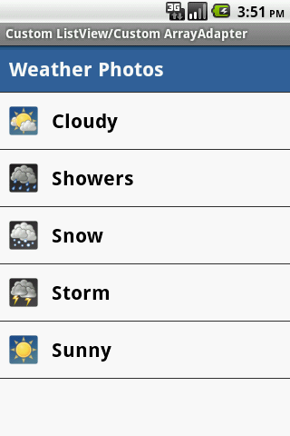
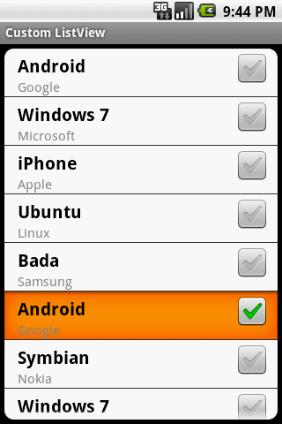
Selection Widgets
Customized Lists

Slide 67
Selection Widgets
Customized Lists
Android provides predefined row layouts for displaying simple lists. However, you may want more control in cases such as:
Not every row uses the same layout (e.g., some have one line of text, others have two)
You need to configure the widgets in the rows (e.g., different icons for different cases)
In those cases, the better option is to create your own subclass of your desired Adapter.

Slide 68
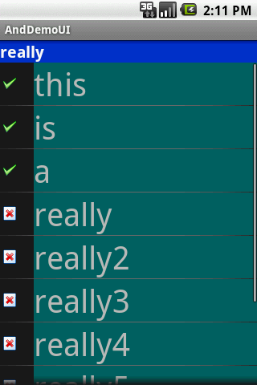
Selection Widgets
Customized Lists: main.xml
<?xml version="1.0" encoding="utf-8"?>
<LinearLayout
android:id="@+id/widget28"
android:layout_width="fill_parent"
android:layout_height="fill_parent"
android:orientation="vertical"
xmlns:android="http://schemas.android.com/apk/res/android"
>
<TextView
android:id="@+id/selection"
android:layout_width="fill_parent"
android:layout_height="wrap_content"
android:background="#ff0033cc”

Slide 69
Selection Widgets
Customized Lists: main.xml
android:textSize="20px"
android:textStyle="bold"
android:textColor="#ffffffff"
>
</TextView>
<ListView
android:id="@android:id/list"
android:layout_width="fill_parent"
android:layout_height="fill_parent"
>
</ListView>
</LinearLayout>

Slide 70

Selection Widgets
Customized Lists: myrow.xml
<?xmlversion="1.0"encoding="UTF-8"?>
<LinearLayout
xmlns:android=http://schemas.android.com/apk/res/android
android:layout_width="fill_parent“
android:layout_height="wrap_content“
android:orientation="horizontal“
>
<ImageView
android:id="@+id/icon“
android:layout_width="22px“
android:paddingLeft="2px“
android:paddingRight="2px“
android:paddingTop="2px“

Slide 71
Selection Widgets
Customized Lists: myrow.xml
android:layout_height="wrap_content“
android:src="@drawable/ok“
/>
<TextView
android:id="@+id/label“
android:layout_width="wrap_content“
android:layout_height="wrap_content“
android:textSize="40sp“
/>
</LinearLayout>

Slide 72
Selection Widgets
Customized Lists: myrow.xml
Package cis493.demoui;
Import android.app.Activity;
Import android.os.Bundle;
Import android.app.ListActivity;
Import android.view.View;
Import android.view.ViewGroup;
Import android.view.LayoutInflater;
Import android.widget.ArrayAdapter;
Import android.widget.ImageView;
Import android.widget.ListView;
Import android.widget.TextView;
publicclassAndDemoUIextendsListActivity{
TextViewselection;

Slide 73
Selection Widgets
Customized Lists: myrow.xml
String[] items= { "this", "is", "a", "really", "really2",
"really3", "really4", "really5", "silly", "list"};
@Override
publicvoidonCreate(Bundle icicle) {
super.onCreate(icicle);
setContentView(R.layout.main);
setListAdapter(newIconicAdapter(this));
selection= (TextView) findViewById(R.id.selection);
}
publicvoidonListItemClick(ListViewparent, View v, intposition, longid) {
selection.setText(items[position]);
}

Slide 74
Selection Widgets
Customized Lists: myrow.xml
classIconicAdapterextendsArrayAdapter{
Activity context;
IconicAdapter(Activity context) {
super(context, R.layout.myrow, items);
this.context= context;
}
publicView getView(intposition, View convertView, ViewGroupparent) {
LayoutInflaterinflater= context.getLayoutInflater();
View row = inflater.inflate(R.layout.myrow, null);
TextViewlabel = (TextView) row.findViewById(R.id.label);
ImageViewicon = (ImageView) row.findViewById(R.id.icon);
label.setText(items[position]);
if(items[position].length() > 4)
icon.setImageResource(R.drawable.delete);

Slide 75
Selection Widgets
Customized Lists: myrow.xml
else
icon.setImageResource(R.drawable.ok);
return(row);
}//getView
}//IconicAdapter
}//AndDemoUI

Slide 76
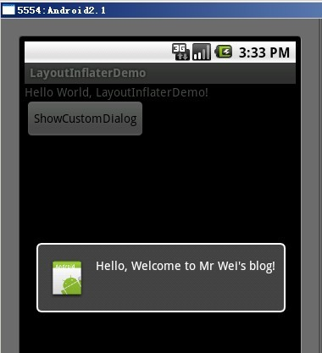
Selection Widgets
Customized Lists: LayoutInflater()

Slide 77
Selection Widgets
Customized Lists: LayoutInflater()
In this case, “inflation” means the act of converting an XML layout specification into the actual tree of View objects the XML represents.
An ArrayAdapter requires three arguments:
Current context
Layout to show the output row
Source data items (data to place in the rows)
The overridden getView() method inflates the layout by custom allocating icons and text taken from data source in the user designed row. Once assembled the View (row) is returned.

Slide 78
Selection Widgets
Appendix A: Android’s Predefined Layouts
This is the definition of: simple_list_item_1. It is just a TextView field named “text1” centered, of large font, and some padding.
<?xml version="1.0" encoding="utf-8" ?>
<!--Copyright (C) 2006 The Android Open Source Project Licensed under the Apache License, Version 2.0 (the "License"); you may not use this file except in compliance with the License. You may obtain a copy of the License at http://www.apache.org/licenses/LICENSE-2.0 Unless required by applicable law or agreed to in writing, software distributed under the License is distributed on an "AS IS" BASIS, WITHOUT WARRANTIES OR CONDITIONS OF ANY KIND, either express or implied. See the License for the specific language governing permissions and limitations under the License.-->

Slide 79
Selection Widgets
Appendix A: Android’s Predefined Layouts
This is the definition of: simple_list_item_1. It is just a TextView field named “text1” centered, of large font, and some padding.
<TextViewxmlns:android="http://schemas.android.com/apk/res/android"
android:id="@android:id/text1"
android:layout_width="fill_parent"
android:layout_height="wrap_content" android:textAppearance="?android:attr/textAppearanceLarge" android:gravity="center_vertical"
android:paddingLeft="6dip"
android:minHeight="?android:attr/listPreferredItemHeight"
/>

Slide 80
Selection Widgets
Appendix A: Android’s Predefined Layouts
This is the definition of: simple_spinner_dropdown_item. Other possible built-in spinner layout is: simple_spinner_item.
<?xml version="1.0" encoding="utf-8"?>
<!--legal comments removed !!! -->
<CheckedTextView
xmlns:android="http://schemas.android.com/apk/res/android"
android:id="@android:id/text1"
style="?android:attr/spinnerDropDownItemStyle"
android:singleLine="true"
android:layout_width="fill_parent"
android:layout_height="?android:attr/listPreferredItemHeight“
android:ellipsize="marquee"
/>

